Slide 1

B2B Sales Summit
June 2011

Slide 2
Agenda
HTC Enterprise YOU
HTC Sensation
HTC Sense 3.0
HTC Double Shot
3LM
HTC Flyer
Notes:
EnterpriseYOU – 15 Min
Sensation – 20 Min
Sense 3.0 – 15 Min
Double Shot – 10 Min
3LM – 10 Min
Flyer – 10 Min

Slide 3


ENTERPRISE

Slide 4


Enterprise Support
ENTERPRISE
HTC Enterprise Support Group
PROFESSIONAL
SERVICES
DEDICATED
ENTERPRISE
SUPPORT
DEVELOPER
SUPPORT

Slide 5
HTC Enterprise Support Group
Support to help you sell
Virtual Sales Support
Pre and post sales support on opportunities pertaining to HTC devices
Field Based Sales Support
Dedicated field based support for operators to educate, enable and support sales

Slide 6





Examples of work
Grammy Musicmapper Application
Rapid development of cross platform app mobile campaign
iPhone and Android offering
Social, Geolocation and content aggregation
Department of Defense
Deep level training on Android OS
NDK and hardware level custom training course
OS security and driver level instruction

Slide 7
Working to enable the enablers
ISV integration support
Work with developers and ISVs to get their applications running successfully on HTC devices
SDK management
Enable and support HTC specific development assets to allow developers to take advantage of HTC specific device features and offerings

Slide 8
Comprehensive Support
ISVs and Developers
Enterprise Customers
T-mobile Business Sales Teams
Enterprise Support Group
Issue support and knowledge
Field Sales Support, collateral, training
Field Sales Support
Outsourced development resources
Consulting and application development
Value added services to sell
Engagement with community and dev resources – evangelism and information on HTC technologies
Comprehensive coverage of ALL areas of enterprise support

Slide 9

Notes:
Features to add
Wifi sharing
Internet calling
HTC Sync

Slide 10

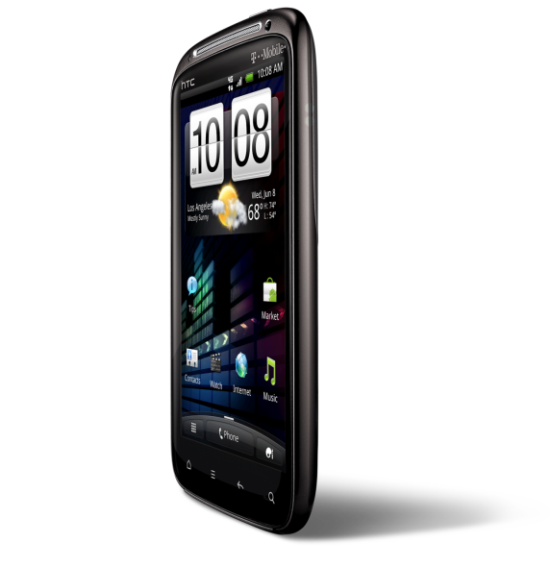
Notes:
Features to add
Wifi sharing
Internet calling
HTC Sync

Slide 11

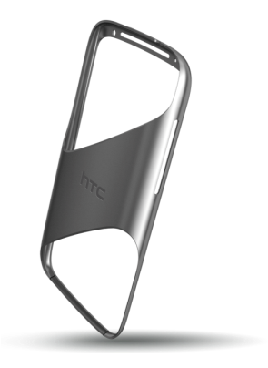

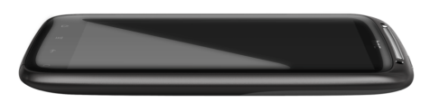
Curved Glass
Slim Profile
Unibody Metal Frame
Notes:
Unibody metal has a premium feel and durability. Feels and looks professional
Countured glass adds to the design and protects screen from getting scratched when placed down on its face.
Thin design adds to the appeal – feels small, acts big

Slide 12
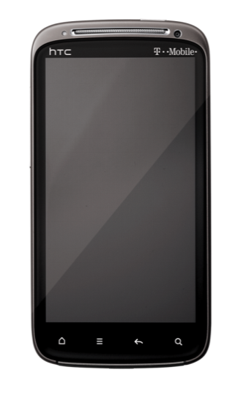
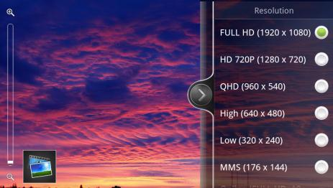
4.3 in qHD Display
Large Brilliant Display
Notes:
Illustrate how the screen is as large as competitive devices out there from other operators - including the EVO and Thunderbolt – yet can still feel compact.
From an aesthetics point of view – the display offers fantastic resolution and can capture and play video in full 1080p

Slide 13
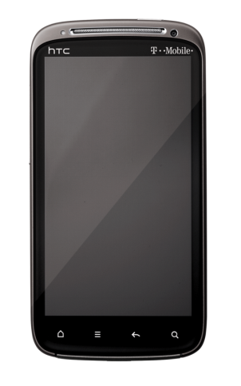
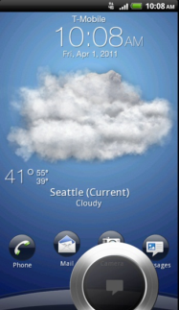
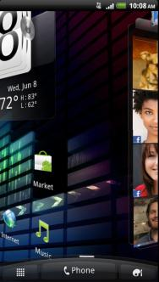
HTC Sense 3.0
Innovative Interfaces
Stunning Visuals
Notes:
Features like the enhanced lock screen showcase how HTC has created more options to quickly get to the information they want. The information is brought to the surface in a new way.
Exciting visuals are part of HTC Sense 3.0. Widgets and home screen elements and transitions leverage perspective and depth and create an interface that leverages 3 dimensions.

Slide 14

Dual Core
Qualcomm 1.2 GHz Snapdragon Processor
Power
Notes:
Faster than ever.
Dual core brings the ability to do more better and more fluid than ever before
Enables a smooth experience in all areas of work and play including multitasking and high-end video capture

Slide 15
HSPA+
14.4 Down
5.6 Up
Speed
Notes:
Faster than ever.
Dual core brings the ability to do more better and more fluid than ever before
Enables a smooth experience in all areas of work and play including multitasking and high-end video capture

Slide 16




Internet Sharing
Share your connection with up to 8 devices
HSPA+
Notes:
Wifi Sharing feature

Slide 17
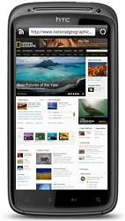

Wireless Printing
Wireless printing of emails, calendar invites, photos, contacts, and web pages

Slide 18

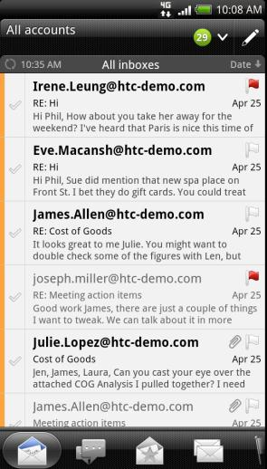
Email
Unified Inbox
Email Preview
Notes:
Best for work and play
Show widgets – calendar, email etc. – bring the experience to the surface
Email = previewing multiple lines at once

Slide 19

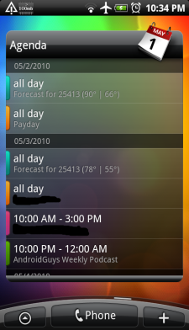
Calendar
Multi Calendar view
Sort
Work and Life
Notes:
Best for work and play
Show widgets – calendar, email etc. – bring the experience to the surface
Email = previewing multiple lines at once

Slide 20
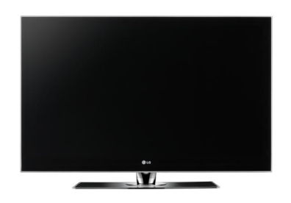




Wireless Projection
Video
Music
Photos

Slide 21



Multimedia Communication
Wifi Calling
Video Chat
Notes:
Internet calling
Video Chat

Slide 22

Launch Date June 15th
^{All Channels}
Processor | Dual core Qualcomm® Snapdragon™, 1.2 GHz
Operating System | Android™ 2.3 platform (Gingerbread) w/ Sense 3.0
Internal Memory | 768 MB RAM, 4 GB Internal Storage (1 GB user addressable)
Display | 4.3” (diagonal) qHD(540x960 pixels)
Network | GSM/EDGE 850/900/1800/1900 MHz
GPS | GPS/AGPS
Camera | 8 megapixel autofocus camera with Dual LED flash
Connectivity | Bluetooth 3.0, Wi-Fi®: 802.11 b/g/n, 3.5 mm audio jack, SDHC capable microSDcard slot (8GB card inc.)
Battery | 1520mAh LiIon

Slide 23



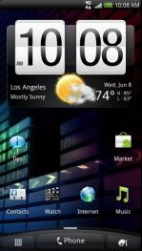


HTC SENSE

Slide 24
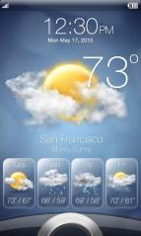
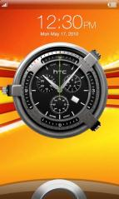
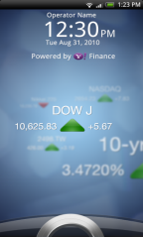
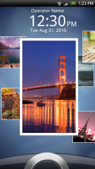

Personalization inspired by YOU
HTC SENSE
Notes:
Illustrates how HTC sense offers options. One unlock screen – different possibilities.

Slide 25
Above and beyond standard Android
HTC SENSE
HTC Sense Enhancements
Expanded Set of Corporate Email Features
Interactive Home Screen Widgets
Intelligent phone features
Aggregated information for ease of access
Notes:
Key areas that HTC sense contributes to enhance the experience
These key areas enhance the usability for business users overall

Slide 26
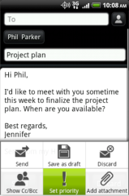
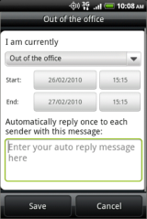

HTC SENSE
Corporate Email Features
Corporate GAL Lookup
Out-of-office settings
Unified Inbox
Microsoft Exchange Policy Support
Support for over 20 Microsoft Exchange management policy and management features including lock, wipe, password enforcement and more
Notes:
Key areas that HTC sense contributes to enhance the experience
These key areas enhance the usability for business users overall

Slide 27
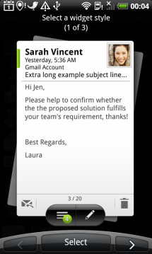

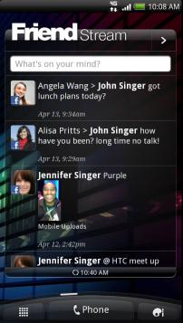
HTC SENSE
Interactive Widgets
Direct access to the information you want
Email
Weather and Time
Social
Notes:
This is an area of innovation that HTC has been working for some time. HTC was never content to just use the standard tools and features in the Android OS and even created exciting Widgets that go above the beyond the capabilities of the standard Android Widgets.
HTC widgets are interactive on the home screen to give users more information on the surface, at-a-glance. It’s this thought and innovation that express the HTC Sense experience.

Slide 28

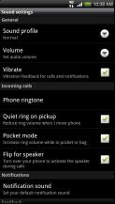
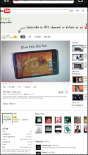
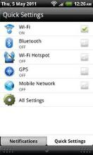
HTC SENSE
Intelligent phone features
Polite Ringer
Flash 10 Support
Quick Settings
Notes:
Features like polite ringer
Flash hardware acceleration for smooth desktop like browsing
Quick settings allows users to quickly get to the settings most commonly used for business and toggle them quickly

Slide 29
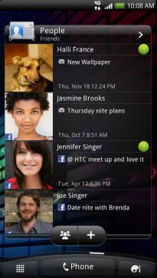
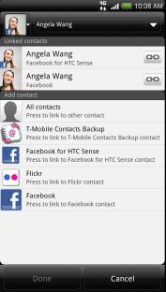
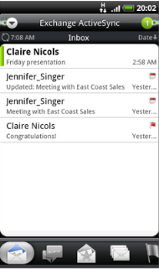
HTC SENSE
Information at your fingers
Link contacts with multiple sources of updates
Sort and find relevant messages
See all communication in one place
Notes:
Features like polite ringer

Slide 30

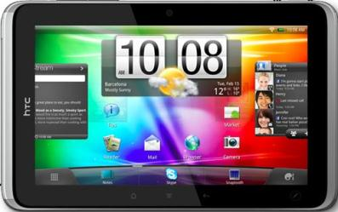
HTC SENSE

Slide 31
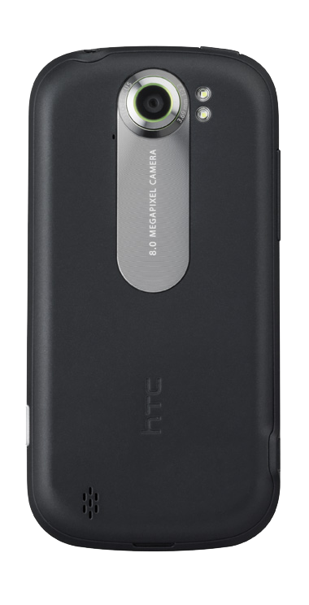
Doubleshot

Slide 32
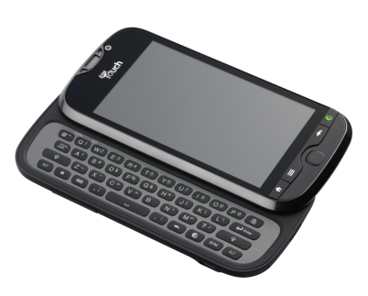
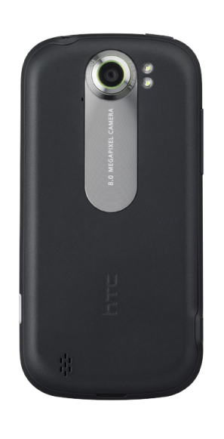
3.8” Display
Doubleshot
1.2 Ghz DUAL processor
HTC SENSE 3.0
8.0MP – Zero Shutter Lag
Low Light Performance
Full QWERTY Keyboard
360 degree image capture

Slide 33
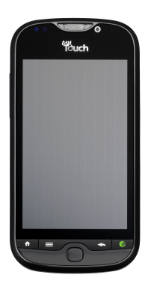
Doubleshot
Release Information
Launch Date July 27th

Slide 34


Slide 35
What is 3LM?
Overview
Addresses Enterprise Needs for Security and Device Management on Android
Secure Remote Access
Device Management
Device Security

Slide 36
Innovative Features
Overview
Hardware Control on Android
Set policies to enable and disable Bluetooth, Camera, SD Card.
Application control on Android
Whitelist and Blacklist Applications that can run on the device
Push and remove applications from devices
Granular permissions on what resources application have access to
Encryption for Android
On-device and SD card encryption for Android.
Secure Remote Access Platform
Offer applications secure encrypted transport to enterprise back-ends
Track Devices
Enable and track devices using GPS through policies

Slide 37
Use
Cases
Notes:
What is it
Who its for

Slide 38



Use
Cases
Loss Remediation
Minimize risk of data exposure on lost devices
1
Device is lost or stolen and reported to IT
2
IT locates device using 3LM console and locks it
3
If device cannot be retrieved, ALL or PART of the data on the device can be wiped
Notes:
Features presented in this slide
Ability to lock device remotely
Ability to locate device from the 3LM console
Ability to selectively wipe devices remotely – all or part of the data on the device can be wiped. This includes wiping the contents of the SD card and local memory

Slide 39



Use
Cases
Location based functionality
Create policies to enable features based on location
1
IT creates policy to disable the camera within certain work zones
User goes into zone where camera usage is not allowed. Camera function is disabled.
2
3
User leaves area where camera is not permitted. Camera function is re-enabled.
Notes:
Features presented in this slide
Ability to set policy based on location
Ability to disable hardware functions

Slide 40






Use
Cases
Application Management
Manage which applications users can use
1
2
3
4
IT remotely deploys policy on which applications can be used on devices
IT remotely installs approved enterprise applications to devices
IT runs audit of devices and finds new unauthorized applications to block
IT REMOVES the unauthorized application and updates policy
!
Notes:
Features presented in this slide
Ability to set blacklist and whitelist of applications that can be run on the device
Ability to remotely push applications and install on devices
Ability to run audits on devices
Ability to uninstall and remove applications from devices

Slide 41





Use
Cases
Permissions based resource access
Lock down which resources remote users can access
IT enables remote access for user and defines which resources they can access across the secure link
1
3LM routes and enables or blocks access to internal resources based on user profile
2
Notes:
Features presented in this slide
Ability to set remote access permissions based on user

Slide 42
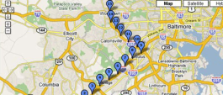

Use
Cases
Unique configurations for business
Track devices and whereabouts
Enable ‘breadcrumb’ tracking of devices to track history of location of a device
Lock down and manage devices to limited purpose
Enable ‘Kiosk-mode’ type scenarios limiting devices to only use one or a few applications
Notes:
Features presented in this slide
Ability to track a user’s whereabouts and ‘breadcrumb’ location history.
Ability to whitelist a single application to lock down device for single purpose use if needed.

Slide 43

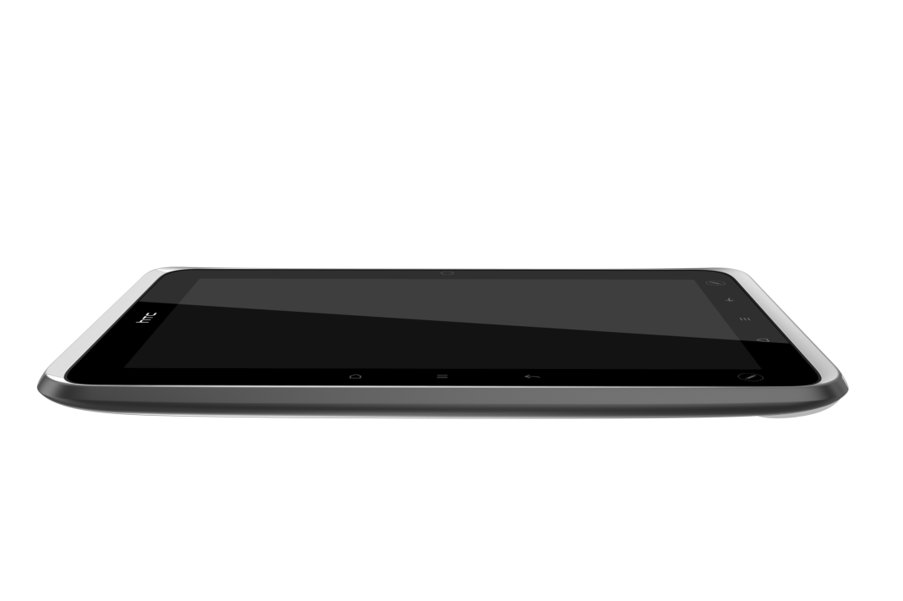
HTC FLYER

Slide 44
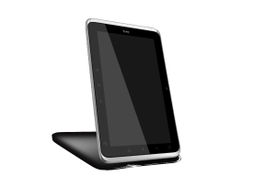


HTC Flyer
Differentiation
Highly Portable
7 inch form factor for 1 handed control and natural writing/input
HTC Scribe Pen
Unique Pen experience that replicates true writing- not just extension of a finger
Out-of-box Integration with wide variety of onboard applications and expansion to more
HTC Apps
HTC Watch, Listen, Play, Reader and HTC Sense apps to provide a full set of preloaded productivity and entertainment features

Slide 45





Work + Life

Slide 46
Entertainment
Key Enablers
HTC Watch
On Demand and offline video purchase through the HTC Watch storefront
HTC Read
Aggregated storefront with access to multiple sources of content including magazines, books and periodicals
HTC Listen
Take your music with you
Access to Amazon Music and breaking content
HTC Play
Access to compelling and groundbreaking games

Slide 47
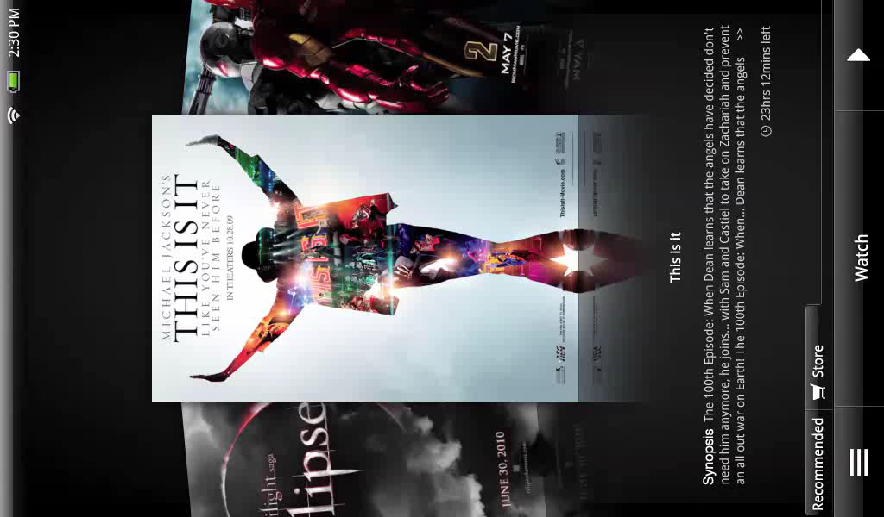
HTC Watch

Slide 48
HTC Read

Slide 49
HTC Listen

Slide 50
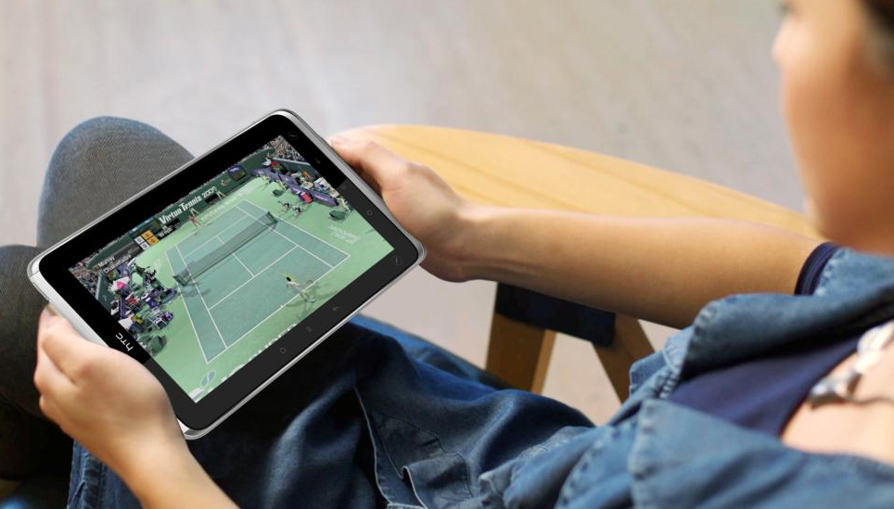
HTC Play
HTC Proprietary and Confidential

Slide 51
Business Productivity

Slide 52
Business and Productivity
Key Enablers
Desktop-like web browsing
Full functional web browser for desktop-like experience and features
Full Email and PIM functions
Microsoft Exchange Email and PIM integration
Unified inbox for organizing and managing work and personal mail
Document handling
All major file formats supported
Printing function available to print on-the-go
Innovative Pen input
Natural and intuitive note taking functionality
Markup and sharing of docs, web pages, etc.

Slide 53
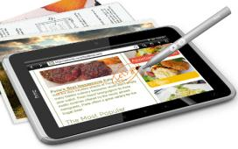
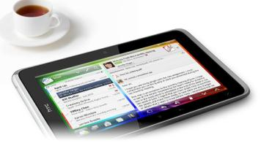
HTC Sense for Personal Productivity
Note Taking
With HTC Notes, you can write it down, add a scribble, a picture, or record the words just the way they were spoken. And since you can sync your notes with Evernote – you can access and review them from your office computer, or another smartphone.
Unified Email
HTC Flyer helps you by merging all your email accounts together into one inbox so you're always organized. They're color coded, so you know what's what, and you can sort them by importance, groups or content..

Slide 54

HTC Sense for Personal Productivity
Office on the go
View and edit Office documents wherever you find yourself. And if the need for a hard copy arises - send it via Wi-Fi to a nearby printer.
Calendar and Events
View all of your calendar appointments on the big 7" screen. Every appointment, birthday, event and holiday gets plenty of space, so you'll never have to squint. It will even sync up with your email account, so everything that happens on your computer, happens on your HTC Flyer

Slide 55
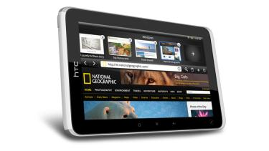
HTC Sense for Personal Productivity
Desktop-like Web Browsing
Conveniently compact and light for travel, yet amazingly powerful, the HTC Flyer tablet with a 7" display and a superfast 1.5 GHz processor is perfect for web browsing at home, in the car or on a busines trip. To make it even better, it features Adobe Flash support, multi-window browsing with pinch to zoom, and a clever quick look-up that lets you tap into Wikipedia, Youtube and other web resources.

Slide 56

HTC Scribe Technology
Unique input technology that allows for true pen- like input separate of touch
SDKs to extend application integration with Pen functionality

Slide 57

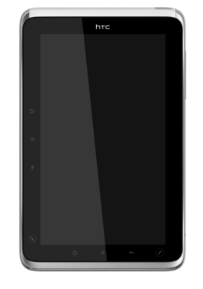
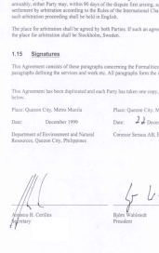



Signature Capture
Built in HTC Pen Functionality
Read, edit, sign and send back PDF files using native HTC Scribe Pen technology on the HTC Flyer
Enterprise Solutions
Android based solutions from leading signature capture vendors makes more possible with HTC Flyer

Slide 58


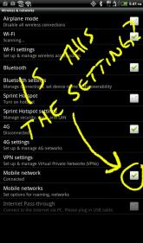

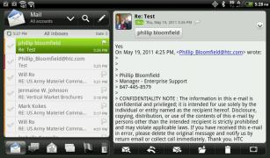
Capture Notes and Send
Mark up anything (including system screens) and send as images

Slide 59

Mark up documents naturally
HTC Scribe Pen features allow for multiple types of markup input including highlight and various types of pens

Slide 60


Slide 61
HTC Scribe SDK
Opening PEN input functionality to 3rd party developers in Q3 2011

Slide 62
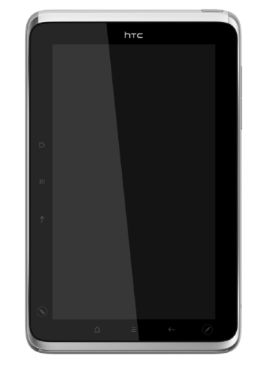
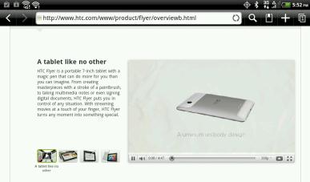
Desktop-like Web Browsing
Hardware Acceleration for a smooth Adobe Flash experience

Slide 63

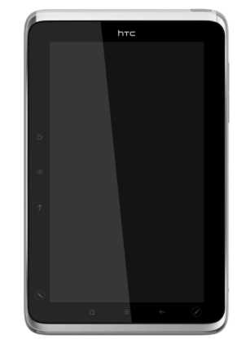
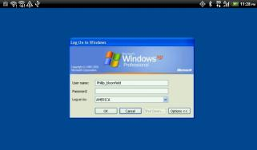
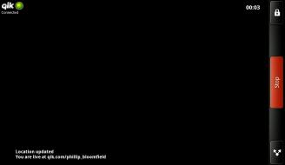


Multimedia and Desktop Apps
Remote Desktop
Video Conferencing

Slide 64
HTC Flyer
Release Information
Launch Date TBD
If launched with Gingerbread
July Launch (30 day OTA upgrade to Honeycomb)
If launched with Honeycomb
Launch will be delayed
Product will be Certified Non-stock
Notes:
Certified Non stock (not in T-Mobile’s inventory)
direct all questions and or concerns about Flyer being non stock to Justin Tacy. (Especially if they have concerns over how being non stock will impact their customers.)

Slide 65



